Slide 1
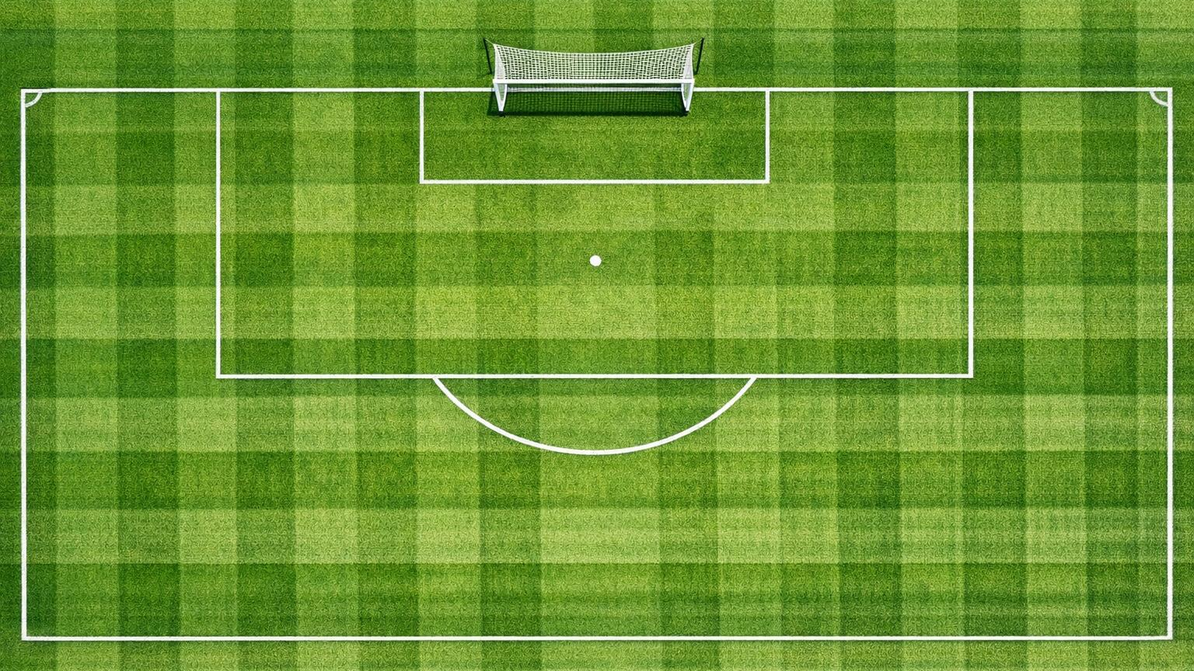
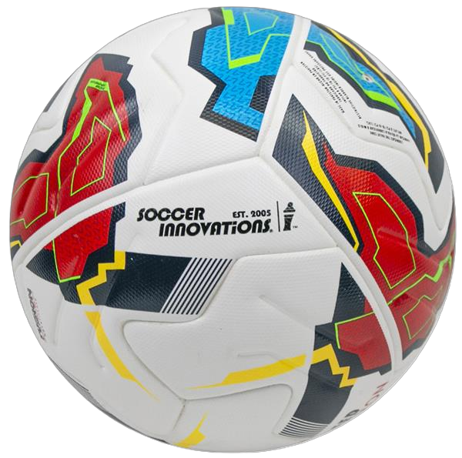
JUST4GK • CROSS ZONES
ZONE 1 — NEAR POST
ZONE 1
SUPPORT
BALL DELIVERED TO
THE NEAR POST AREA
CONNECTING WITH THE
TEAM THROUGH POSITIONING,
INSTRUCTION AND ATTACK
TO DOMINATE THE NEAR POST
EFFECTIVE ACTIONS TO ATTACK
THE CROSS AT ITS HIGHEST POINT
NEAR
POST
ZONE 1 — NEAR POST
ATTACK AGGRESSIVELY • TAKE AT HIGHEST POINT • STRONG HANDS • NO HESITATION
“THIS IS YOUR BALL — OWN IT”
SITUATION
ASSESSMENT
MOVEMENT
STANCE
ACTION

Slide 2
READ THE FLIGHT • COMMUNICATE "KEEPER!" • CATCH, PUNCH, OR HOLD
JUST4GK • CROSS ZONES
ZONE 2 — CENTRAL
ZONE 2
BALL DELIVERED TO
THE 6-YARD BOX AREA
EFFECTIVE ACTIONS TO COMMAND
THE BOX AND MAKE THE RIGHT CALL
CENTRAL
6-YD BOX
SUPPORT
COMMANDING THE BOX
THROUGH POSITIONING,
COMMUNICATION AND
DECISIVE ACTION
ZONE 2 — CENTRAL / 6-YARD BOX
“CALL EARLY. COMMIT FULLY. NO MAN’S LAND KILLS KEEPERS.”
SITUATION
ASSESSMENT
MOVEMENT
STANCE
ACTION

Slide 3
JUST4GK • CROSS ZONES
ZONE 3
ZONE 3 — FAR POST
SUPPORT
CONNECTING WITH THE
TEAM BY TRACKING THE BALL,
DECIDING AND COMMITTING
WITH FULL AUTHORITY
BALL DELIVERED TO
THE BACK POST AREA
FAR
POST
EFFECTIVE ACTIONS TO TRACK
AND DEAL WITH FAR POST CROSSES
ZONE 3 — FAR POST
TRACK LATERALLY • STAY ON TOES • COME WITH AUTHORITY • OR LEAVE IT
“TRACK, DECIDE, COMMIT — NEVER HALF MEASURES AT THE FAR POST.”
SITUATION
ASSESSMENT
MOVEMENT
STANCE
ACTION

Slide 4
JUST4GK • CROSS ZONES
ZONE 4
ZONE 4 — CUTBACK
CUTBACK
SECOND BALL
SUPPORT
BALL PLAYED BACK TO
THE PENALTY SPOT AREA
STAYING HOME AND
SUPPORTING THE TEAM
THROUGH POSITIONING
AND READINESS TO SAVE
EFFECTIVE ACTIONS TO DEAL WITH
CUTBACKS AND SECOND-BALL SITUATIONS
ZONE 4 — CUTBACK
“READ THE CUT — RESET BEFORE THE SHOT ARRIVES.”
STAY HOME • READ THE CUT • RESET STANCE • EXPECT THE SHOT
SITUATION
ASSESSMENT
MOVEMENT
STANCE
ACTION

