Slide 1
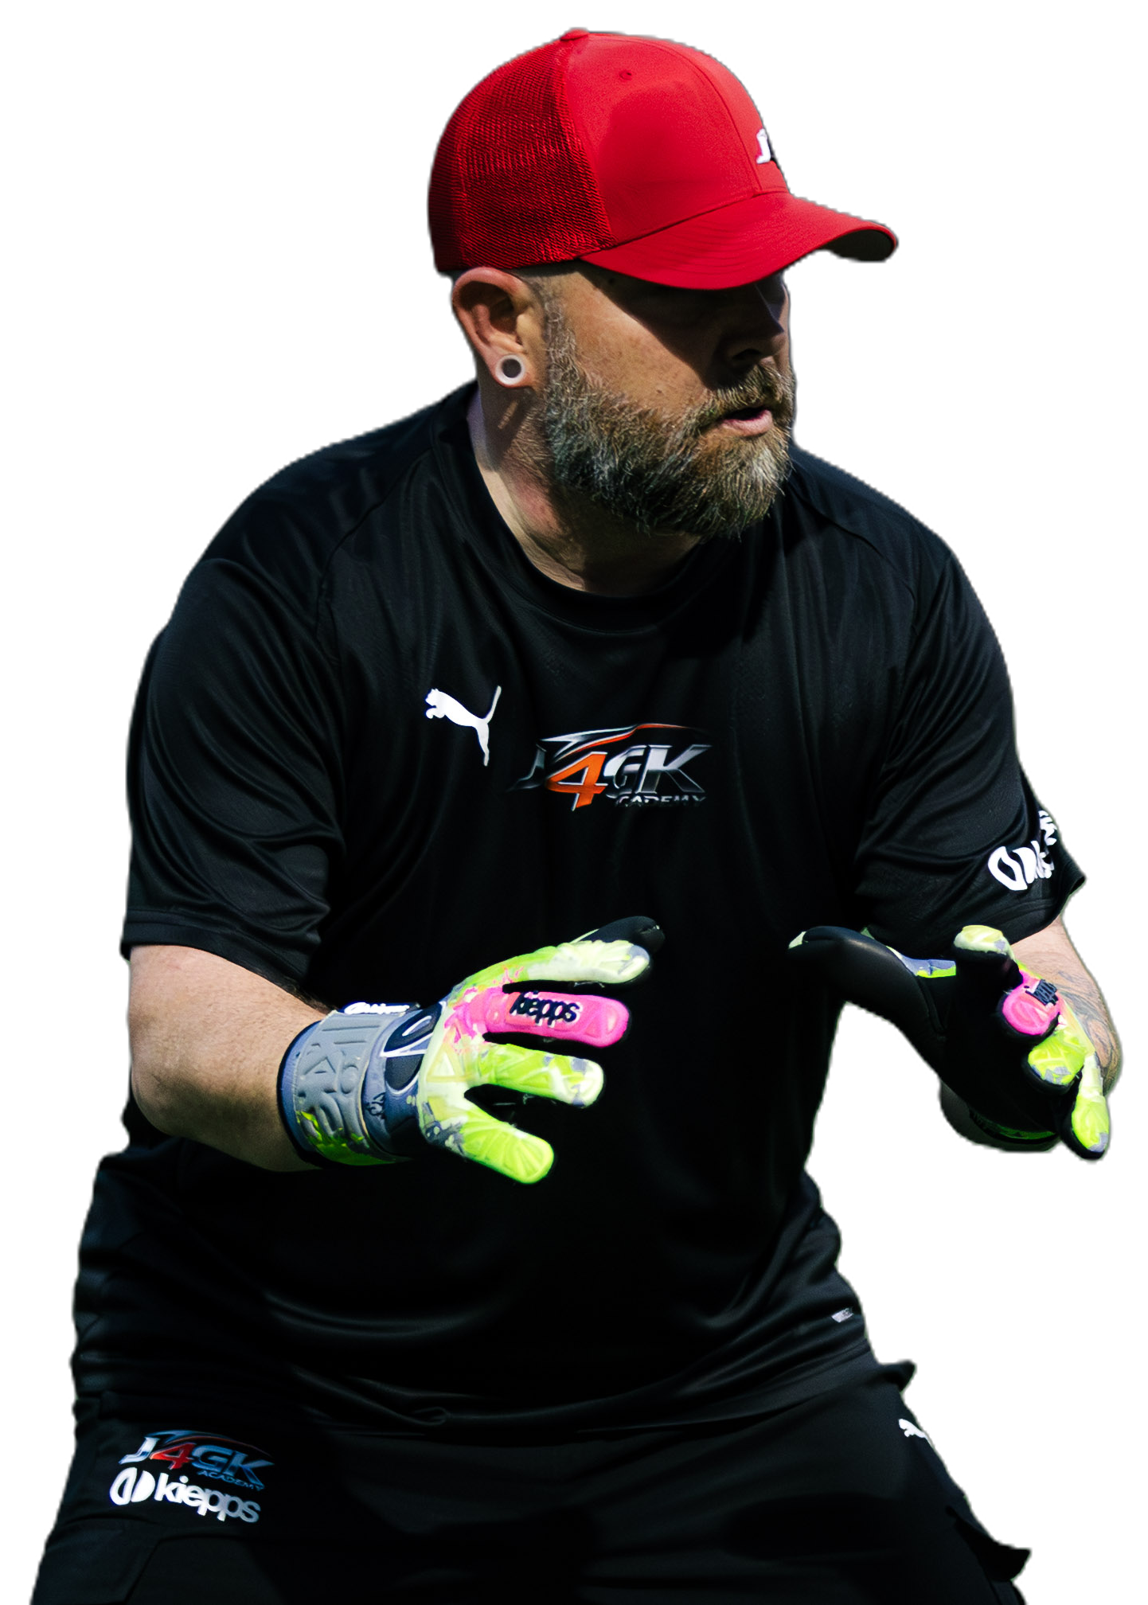
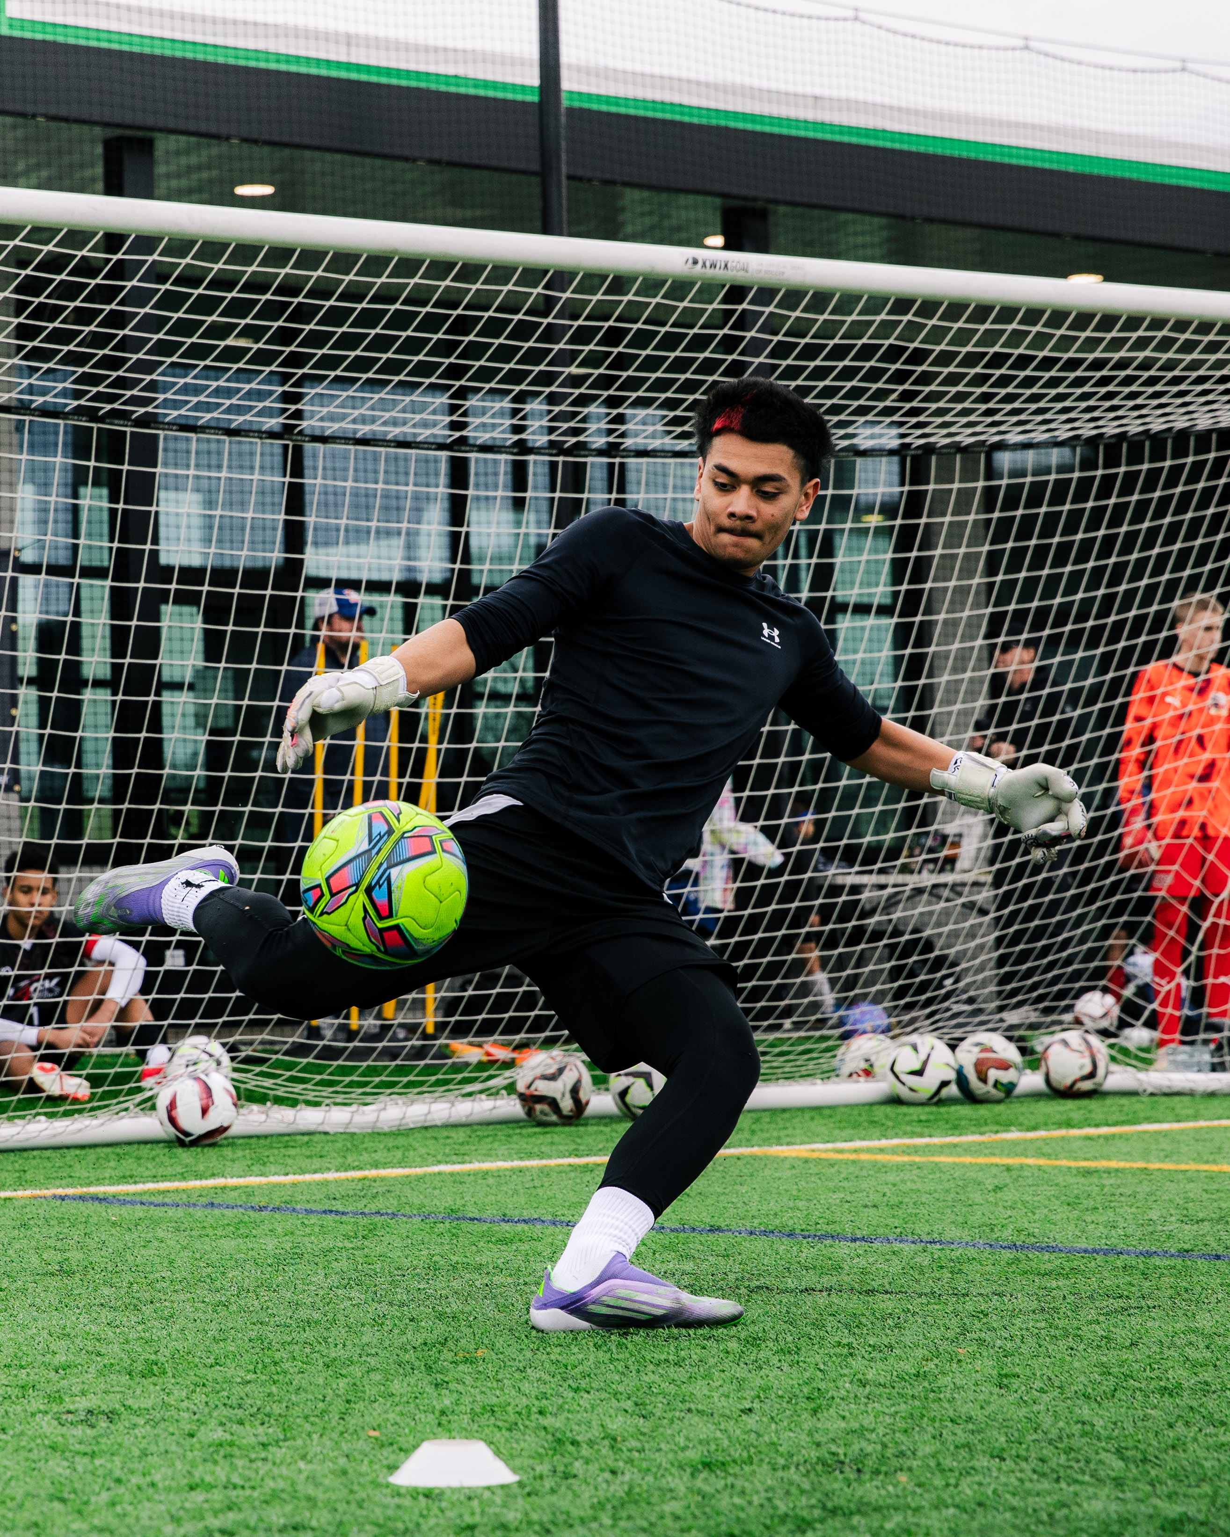
JUST4GK TRAINING ACADEMY
01
TECHNICAL
Goalkeeper
Vocabulary
& Terminology
Mechanics · Handling · Saves
02
TACTICAL
Positioning · Angles · Decisions
A complete four-section reference guide covering technical mechanics,
tactical positioning, physical athleticism, and communication & mindset
— built for goalkeepers, coaches, and parents.
03
PHYSICAL
Movement · Athleticism · Recovery
04
COMMUNICATION & MINDSET
Commands · Leadership · Mental
Just4GK • Goalkeeper-Exclusive Training • www.just4gk.net • jerimy@just4gk.net

Slide 2

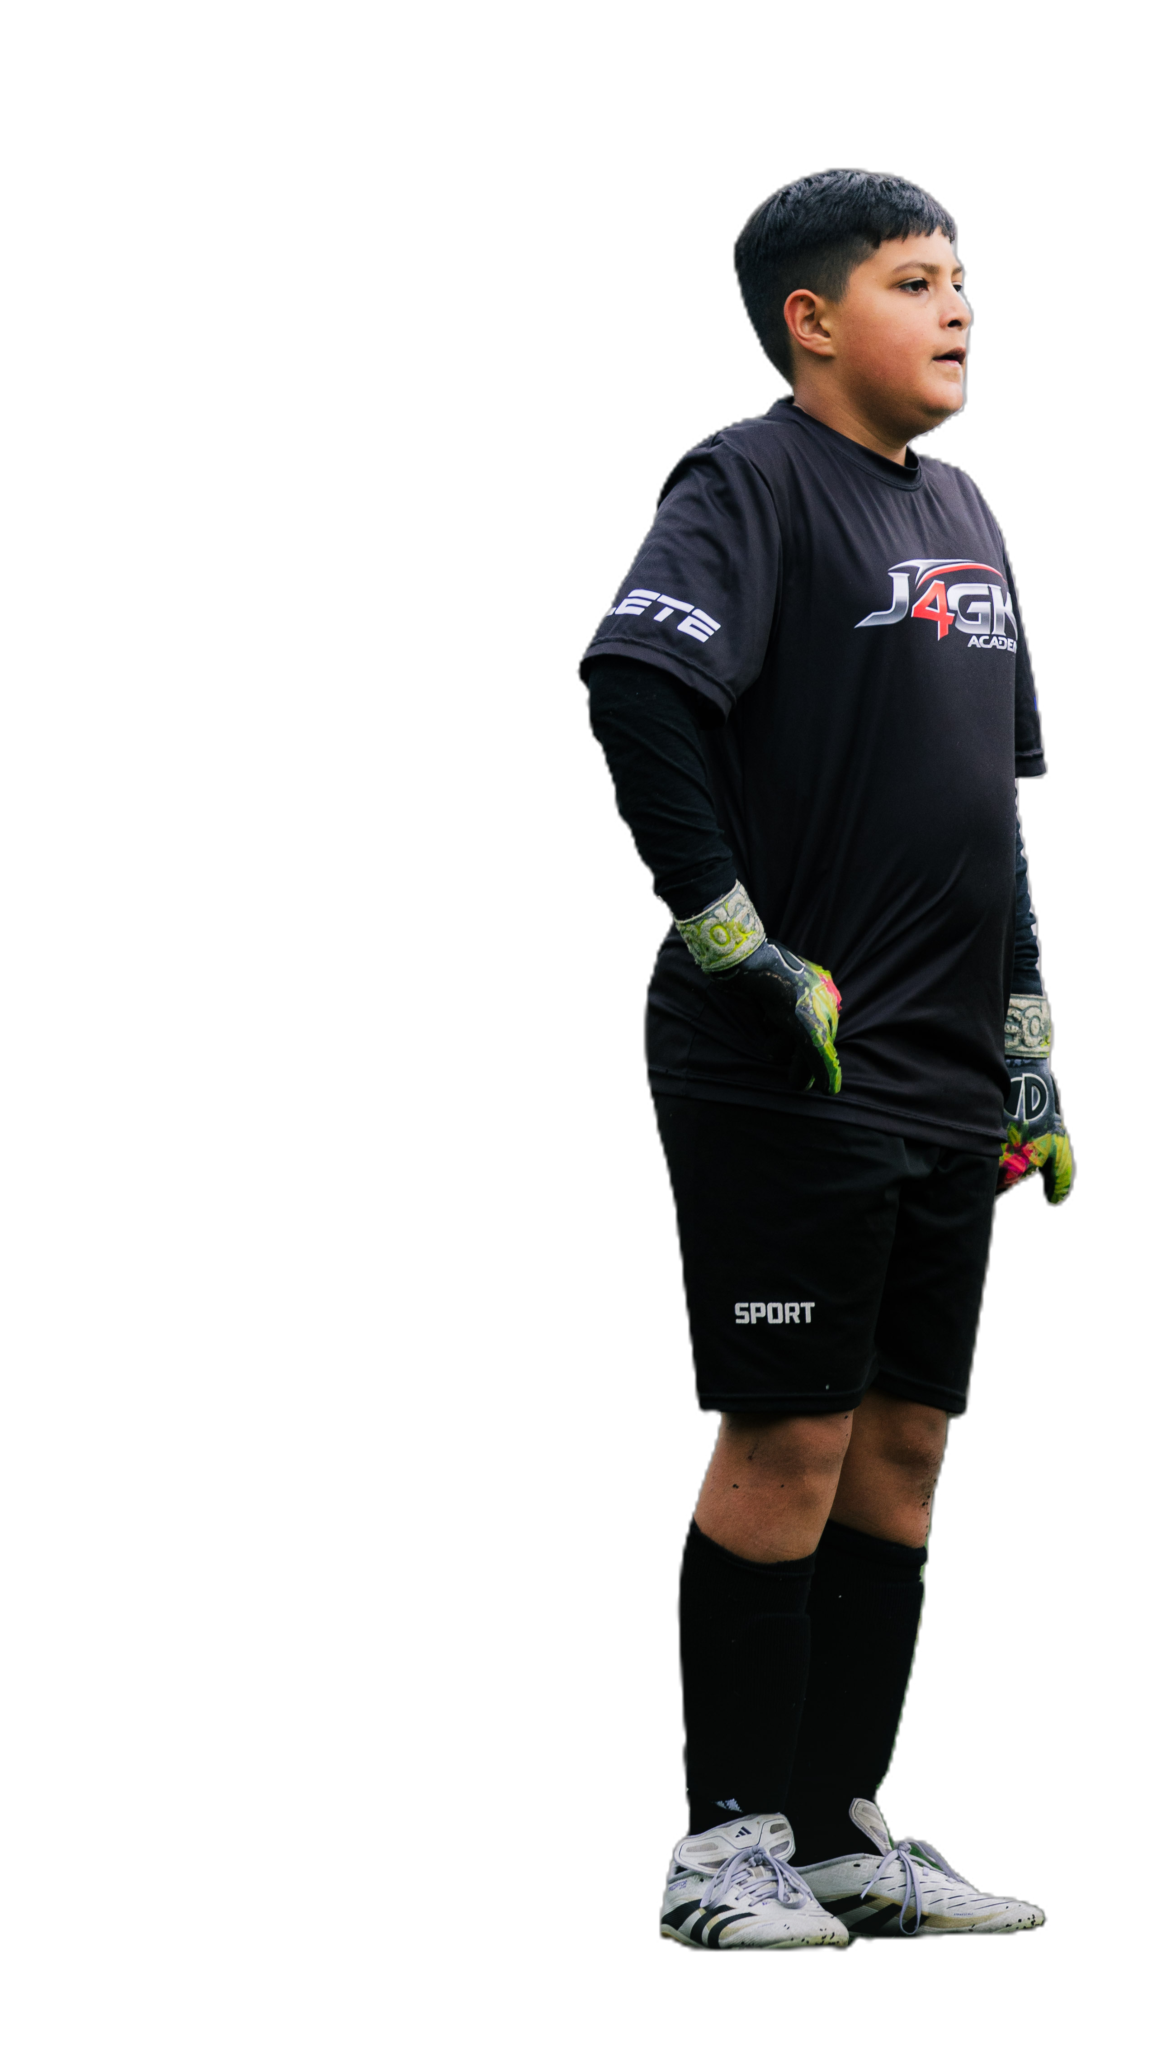
SECTION 1
TOPICS COVERED
TECHNICAL
TERMINOLOGY
BODY MECHANICS & STANCE
Set position · Athletic stance · Hip hinge · Center of gravity
HAND & WRIST MECHANICS
W-grip · Scoop · Fingertip save · Soft hands · Palm save
01
CATCHING TECHNIQUES
Secure catch · Contour · High catch · Collapse · Cradle
SAVE TYPES & TECHNIQUES
Reflex · Diving · Spread · Parry · Smother · Double save
Mechanics · Handling · Saves
DIVING MECHANICS & FOOTWORK
Lead hand · Power step · Collapse dive · Extension dive · Landing
Just4GK • Goalkeeper-Exclusive Training • www.just4gk.net • jerimy@just4gk.net

Slide 3
TECHNICAL
BODY MECHANICS & STANCE
10 terms · Fundamentals of goalkeeper movement and positioning
SET POSITION | The ready stance before a shot — feet shoulder-width apart, slight bend in knees and hips, weight on the balls of the feet.
READY POSITION | Same as set position; the athletic base a keeper returns to between every action throughout the match. Also known as the position when a keeper is preparing to set with mini-hops just before a shot or performing a goalkeeper action
WEIGHT TRANSFER | Shifting body weight forward or laterally to initiate explosive movement — the bridge between stance and action.
HIP HINGE | Bending at the hips (not the waist) to lower the center of gravity — improves reaction speed and power generation.
BASE OF SUPPORT | The width between the feet that determines balance, stability, and the ability to move explosively in any direction.
ATHLETIC STANCE | A forward-leaning, bent-knee position that allows explosive movement in any direction — the physical foundation of goalkeeping.
STAGGERED STANCE | One foot slightly in front of the other — used during crosses or when reading a ball in flight for quicker directional adjustment.
BODY SHAPE | How a keeper angles their torso, shoulders, and hips relative to the ball and target — affects every save and distribution.
CENTER OF GRAVITY | The body's balance point — kept low to allow quick directional changes and explosive lateral movement across the goal.
KNEES OVER TOES | Proper knee alignment during diving and landing mechanics — critical for injury prevention and explosive push-off power.
HAND & WRIST MECHANICS
10 terms · Hand & Wrist Mechanics
TECHNICAL
W-GRIP | Proper hand position for catching above the waist — thumbs almost touching behind the ball, forming a "W" for maximum security.
SCOOP / BUCKET HANDS | Hand position for low balls — fingers pointed down, pinkies together, palms forming a "bucket" to receive the ball safely.
FINGER SPREAD | Maximizing surface area by fully extending all fingers on the ball — creates a more secure catch and reduces rebound risk.
PALM SAVE | Using the heel of the palm to deflect a ball away when a clean catch isn't possible — directional control is the priority.
FINGERTIP SAVE | Redirecting a ball over or around the post using fingertips — used on shots at the absolute edge of the keeper's reach.
TWO-HANDED SAVE | Using both hands together to parry or push a ball away — provides more force and directional control than a single hand.
ONE-HANDED TIP | Redirecting a ball just over the crossbar with a single hand — used when the ball is out of safe catching range.
WRIST SNAP | A quick flick of the wrist to redirect a ball during a reflex save — generates quick directional force without a full arm swing.
HAND POSITION | Where the hands are placed on the ball relative to the shot — behind and slightly behind center for maximum catching control.
SOFT HANDS | Absorbing pace from a powerful shot rather than letting the ball rebound — the difference between a clean catch and a dangerous spill.

Slide 4
TECHNICAL
CATCHING TECHNIQUES
8 terms · Types of catches and catching principles
SECURE CATCH | A clean, two-handed catch where the ball is fully controlled and brought into the body — the gold standard of goalkeeper handling.
CHEST / BODY CATCH | Pulling the ball into the chest for added security on shots hit directly at the keeper — eliminates rebound completely.
CONTOUR CATCH | Wrapping the hands and body around the ball to eliminate any chance of a spill — used on firm, well-struck shots.
HIGH CATCH | Catching above head height — requires a W-grip with arms fully extended and elbows slightly bent to absorb pace.
BOX CATCH | Attacking and claiming a high cross at the highest point within the penalty area — requires timing, leap, and commanding position.
REVERSE CATCH | Catching a ball that curves or bends back toward the keeper mid-flight — requires late adjustment and strong hands.
COLLAPSE CATCH | Catching while going to ground — wrapping the ball before turf contact prevents spills and protects against challenge.
CRADLE | Bringing the ball securely into the body after catching — protects it from physical challenge and signals full control to teammates.
SAVE TYPES & TECHNIQUES
15 terms · Save Types & Techniques
TECHNICAL
REFLEX SAVE | A reaction save made with little time to set — relies on muscle memory and trained instinct over prepared technique.
DIVING SAVE | Extending the body fully to one side to reach a ball requiring the keeper to leave the ground entirely.
EXTENSION SAVE | A full-stretch dive where the body is completely elongated to reach a ball at maximum possible distance.
REACTION SAVE | Made on a deflection or close-range shot with no setup time — pure reflex and trained body positioning.
CLOSE-RANGE SAVE | A save made when a striker is very near — requires the keeper to spread big while staying compact and low.
POST SAVE | Diving and saving with the hand closest to the post on a ball near the goal frame — near-post protection.
DOUBLE SAVE | Making a second save after a rebound from the first — demands instant recovery and renewed readiness.
GROUND SAVE | A save made on a low, rolling, or bouncing ball using a collapse or smother technique to cover it.
SMOTHER | Collapsing the full body over a loose ball to eliminate the rebound completely and end the danger.
TWO-HANDED SAVE | Using both hands together to parry or push a ball away for maximum force and directional control.
SPREAD SAVE | Expanding the body — arms wide, legs split — to make the goal as small as possible in a 1v1 situation.
BLOCK SAVE | Using the body as a barrier to stop the ball rather than catching or deflecting — absorbs the shot completely.
POINT-BLANK SAVE | A save made with almost no distance between keeper and shooter — reaction speed is everything in this moment.
PARRY | Intentionally deflecting the ball away from goal when a clean hold isn't possible due to pace or challenge.
OVER-THE-BAR SAVE | Tipping or palming a ball up and over the crossbar to prevent a goal — often a fingertip action at full stretch.

Slide 5
TECHNICAL
DIVING MECHANICS & FOOTWORK
16 terms · Diving technique and movement patterns
LEAD HAND | The bottom hand closest to the ground during a dive — makes first contact with the ball before the top hand secures it.
TOP HAND | The upper hand during a dive — secures the ball after the lead hand makes initial contact with the shot.
POWER STEP | The final step before launching into a dive — generates explosive lateral momentum and determines dive range.
PUSH-OFF FOOT | The foot that drives the body into the dive — always opposite to the direction of the dive for maximum power.
HIP DRIVE | Explosively driving the hips laterally to initiate a dive — the primary engine of diving range and speed.
COLLAPSE DIVE | A short, low dive for balls close to the body — keeper collapses sideways rather than launching into full extension.
EXTENSION DIVE | A full dive for balls farther away — requires a push-off, hip drive, and complete lateral body extension.
LANDING TECHNIQUE | Leading with the hip and thigh on landing — never the knee or elbow — protecting the body and enabling quick recovery.
RECOVERY POSITION | Getting back to feet after a dive — quickly returning to the ready stance to deal with any rebound or follow-up shot.
GROUND MECHANICS | How a keeper controls the ball and body after going to ground — includes rolling, holding, and recovery movement.
SHUFFLE STEP | Small, lateral steps used to adjust position quickly without crossing the feet — maintains balance and readiness.
CROSSOVER STEP | Crossing one foot over the other to cover more ground laterally at speed over a longer distance.
DROP STEP | A quick backward diagonal step used to quickly adjust to a ball played behind or over the keeper's head.
FORWARD MOMENTUM | Moving toward the ball to cut down the angle or attack the play aggressively — controlled aggression in action.
LATERAL MOVEMENT | Side-to-side footwork to track the ball or adjust positioning along the goal line and penalty area.
ARC MOVEMENT | Moving along a curved path rather than straight to maintain proper angle while shifting position laterally.

Slide 6
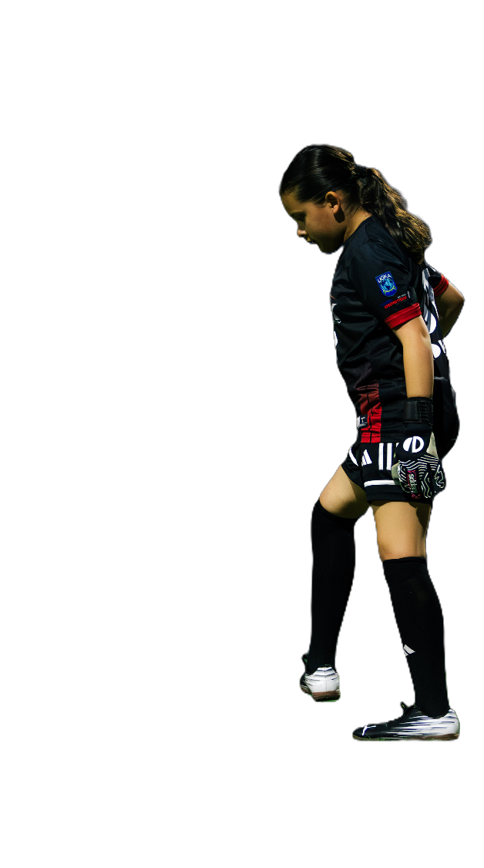
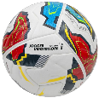
SECTION 2
TOPICS COVERED
TACTICAL
TERMINOLOGY
ANGLE PLAY & POSITIONING
Angle reduction · Bisecting · Depth · Near/far post · Working distance
GOAL LINE & SPACE MANAGEMENT
High line · Defensive third · Penalty area · Recovery run · Sweeper
02
DECISION-MAKING FRAMEWORK
Catch vs punch · Go vs stay · Commit vs delay · Early decision
1V1 & CROSSES
Narrowing angle · Forcing wide · Claiming · Box dominance · Inswinger
Positioning · Angles · Decisions
SET PIECES & SPATIAL AWARENESS
Wall organization · Corner position · Scanning · Anticipation
Just4GK • Goalkeeper-Exclusive Training • www.just4gk.net • jerimy@just4gk.net

Slide 7
TACTICAL
ANGLE PLAY, POSITIONING & SPACE MANAGEMENT
20 terms · Angle reduction, depth, and goal line principles
ANGLE REDUCTION | Moving off the goal line toward the ball to shrink the shooter's visible target — the core principle of all GK positioning.
CUTTING THE ANGLE | Positioning the body to eliminate as much of the goal as possible from the shooter's perspective before the shot.
Ball-Line | Standing in the path of the shot that equally divides the shooting angle between both posts — the mathematical basis of optimal positioning.
NEAR POST | The goalpost closest to where the ball currently is — the keeper's first responsibility to cover at all times.
FAR POST | The goalpost farthest from the ball — must be accounted for in positioning and communication on crosses.
CENTRAL POSITION | Being positioned on the bisector between the ball and both posts — the optimal starting reference point.
DEPTH | How far off the goal line the keeper positions — too shallow gives up angle; too deep gives the shooter too large a target.
WORKING DISTANCE | The optimal distance off the line that balances angle coverage with recovery ability on balls played over or behind.
OVER-COMMITTING | Moving too far off the line or too early — leaves the goal exposed and creates a scoring opportunity via chip or lob.
STARTING POSITION | The base position taken before the ball is played — determined by ball location, defensive shape, and phase of play.
GOAL LINE | The line the keeper defends — understanding when to be on it vs. off it is a core tactical skill for every keeper.
SWEEPER POSITION | A wider or deeper position taken in anticipation of balls played behind the defensive line — requires early game reading.
HIGH LINE | When the defense pushes high, requiring the keeper to act as a sweeper covering space behind the defensive block.
DEFENSIVE THIRD | The portion of the field nearest the goal — keepers must be in full command of all decisions and communication here.
PENALTY AREA | The 18-yard box — the keeper's primary zone of command for aerial balls, crosses, and through balls played in behind.
SIX-YARD BOX | The smaller box directly in front of goal — keeper's priority zone for close-range crosses and corner deliveries.
RECOVERY RUN | Sprinting back to goal quickly after being caught out of position on a sweeping action or wide play.
DEPTH ADJUSTMENT | Moving the starting position deeper or shallower based on ball location and the team's defensive shape.
DEAD BALL LINE | The end line — keepers must judge whether to play a ball going out or cut it off before the byline.
COVER SHADOW | The zone behind a defender that the keeper owns if the defender is bypassed — requires proactive awareness.
TACTICAL
DECISION-MAKING FRAMEWORK
10 terms · Decision-Making Framework
CATCH VS PUNCH | Reading whether it's safer to catch a ball for full control or punch it clear — determined by challenge, pace, and position.
HOLD VS RELEASE | Deciding whether to keep the ball after a save or immediately distribute to start a counterattack and exploit space.
ATTACK VS DEFEND | The decision to come off the line and claim a ball versus staying to defend the goal frame — requires early commitment.
GO VS STAY | The split-second read on whether to come for a cross, through ball, or aerial ball versus holding position to cover the goal.
COMMIT VS DELAY | In a 1v1, choosing when to fully commit to a save versus holding to force the striker wide or wait for their shot.
INTERCEPT VS COVER | Choosing between stepping out to cut off a pass versus holding position to cover the space behind the defensive line.
SHOT VS CROSS READ | Pre-reading whether an attacking player is likely to shoot or deliver the ball — dictates positioning before the action.
THROUGH BALL READ | Anticipating a ball played behind the defensive line and deciding early whether to intercept or hold defensive coverage.
EARLY DECISION | Committing to a course of action before the ball arrives — eliminates hesitation, prevents half-actions, projects confidence.
LATE DECISION | Waiting too long to commit — leads to indecision, hesitation, and dangerous half-actions that directly cause goals.

Slide 8
TACTICAL
1V1 SITUATIONS
10 terms · One-on-one terminology and principles
1V1 | A direct confrontation between the goalkeeper and a lone attacker with a clear path to goal — requires angle, timing, and decision-making.
NARROWING THE ANGLE | Coming off the line toward the attacker to reduce the visible goal target — the primary tool a keeper has in any 1v1.
SET AND WAIT | Stopping movement and settling into a ready position before the striker shoots — avoids being caught mid-step when the shot comes.
FORCING WIDE | Body positioning designed to push the attacker away from center and toward a less dangerous shooting angle.
STAYING BIG | Maintaining a large body shape — arms out, body upright — to block as much of the goal as possible without committing too early.
CLOSING DOWN | Aggressively moving toward the attacker to reduce their time and space to shoot — controlled speed is essential to avoid being chipped.
READING THE STRIKER | Watching the attacker's hips, plant foot, and body shape to anticipate shot direction before the ball is struck.
DELAYING | Slowing the 1v1 situation to allow defenders to recover — not always about making the save; time is the asset.
PENALTY KICK READ | Studying the shooter's run-up, plant foot, and eye direction to anticipate shot direction on a penalty kick.
SPREAD SAVE | Expanding the body wide — arms out, legs split — in a 1v1 to cover as much of the goal frame as physically possible.
TACTICAL
CROSSES & AERIAL SITUATIONS
13 terms · Cross-reading, claiming, and aerial challenge terminology
CLAIMING | The decision to come off the line and take full ownership of a crossed ball — requires a loud call, decisive movement, and peak timing.
CLAIMING TERRITORY | Establishing command of the penalty area by consistently and confidently coming for all catchable crosses throughout the game.
BOX DOMINANCE | Controlling all aerial balls within the penalty area through communication, timing, and decisive action every time.
TIMING THE JUMP | Attacking a high ball at the peak of the jump — taking off at the right moment to reach the ball first and highest. (Your Highest Point)
FLIGHT OF THE BALL | Reading the trajectory, pace, and spin of a crossed ball to anticipate where it will arrive before it gets there.
INSWINGER | A cross that curves toward the goal — more dangerous than an outswinger; requires earlier decision-making and aggressive claiming.
OUTSWINGER | A cross that curves away from goal — easier for the keeper to claim but can deceive defenders and create second-ball situations.
NEAR POST CROSS | A cross aimed at the front post area — requires the keeper to attack the ball aggressively with a forward-moving jump.
FAR POST CROSS | A cross aimed toward the back post — keeper must track movement and potentially adjust from an initial near-post starting position.
SECOND BALL | A loose ball after an aerial challenge — keeper must quickly decide whether to claim, parry clear, or organize defenders.
PUNCH DECISION | Choosing to punch rather than catch on a contested aerial ball — must be decisive and directed well away from danger.
DIRECTED PUNCH | A two-fisted punch aimed intentionally away from the goal — distance and direction both matter; not just a blind clearance.
LATE CROSS | A ball delivered after a cut-back or delay — requires positional adjustment and timing recalculation from the keeper.

Slide 9
TACTICAL
SET PIECES & SPATIAL AWARENESS
17 terms · Dead ball positioning, scanning, and game reading
WALL ORGANIZATION | Directing defenders into a wall on a free kick — keeper sets number, position, and gap before organizing their own placement.
WALL COVERAGE | The near post side covered by the wall — keeper positions to protect the far post and any shots over or around.
CORNER POSITION | Starting near the front post on corners to allow forward movement and a clear view of the cross as it comes in.
POST REFERENCE | Touching or lining up against the near post before moving — a starting reference point before adjusting to the delivery.
FREE KICK SET | The complete pre-kick setup — wall placed, keeper positioned, all communication finished before the ball is struck.
SHORT CORNER READ | Recognizing a short corner early and adjusting position for a different delivery angle — avoids being caught out.
PENALTY POSITION | Centered on the goal line, reading the shooter's run-up, plant foot, and eye direction before the kick is taken.
NEAR POST CORNER RUN | The dangerous near-post flick-on on corner kicks — keeper must react quickly from an early starting position.
SCANNING | Constantly checking over the shoulder to build a picture of player positions before receiving the ball or acting.
ANTICIPATION | Reading the game ahead of time to position correctly before the threat fully develops — acting before being reactive.
PRE-READING | Identifying attacking patterns, player tendencies, or ball trajectory before any action is required from the keeper.
PERIPHERAL VISION | Using side vision to track multiple players while staying focused on the ball — a trainable perceptual skill.
PICTURE-BUILDING | Scanning the field to mentally map where teammates, opponents, and space are before receiving the ball.
POSITIONING TRIGGER | A cue — pass direction, player run, dribble — that tells the keeper when and how to adjust their position proactively.
TRANSITION READ | Recognizing when the game switches attack to defense (or vice versa) and immediately adjusting position accordingly.
GAME SITUATION AWARENESS | Understanding the score, time, and game context when making decisions — risk management applied in real-time.
SECOND PHASE AWARENESS | Being ready for what happens after the initial action — a rebound, deflection, or transition that immediately follows.

Slide 10
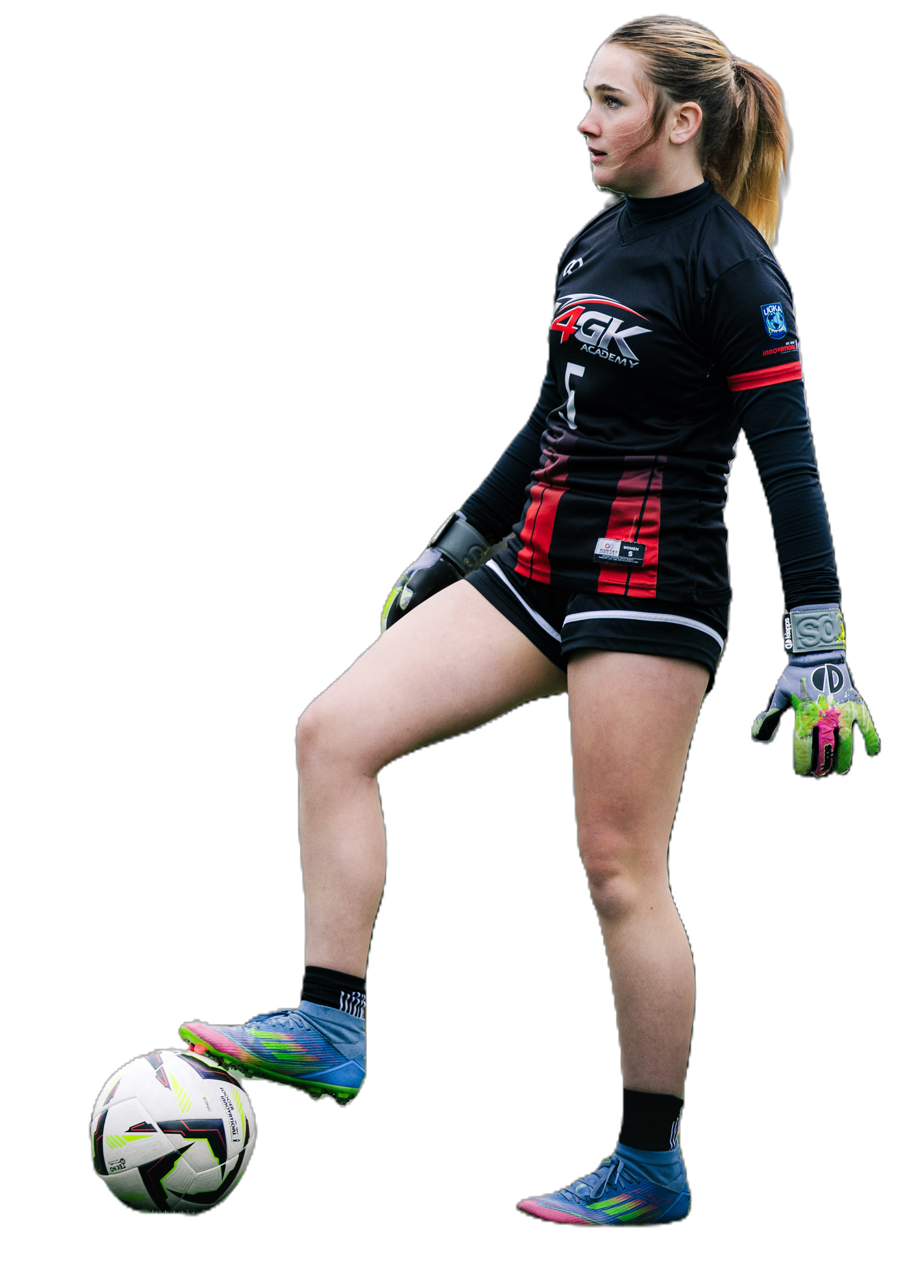
SECTION 3
TOPICS COVERED
PHYSICAL
TERMINOLOGY
SPEED & EXPLOSIVE MOVEMENT
Acceleration · Reactive speed · Linear & lateral speed · Burst
AGILITY, QUICKNESS & REACTION
COD · Reactive agility · Reaction time · Hand speed · Footwork speed
03
POWER, STRENGTH & JUMPING
Explosive power · Hip power · Ground force · Vertical jump · Timing
SAQ TRAINING & BALANCE
Plyometrics · Box jumps · Lateral bounds · Mirror drills · Proprioception
Movement · Athleticism · Recovery
RECOVERY & INJURY PREVENTION
Load management · Prehab · Aerobic base · Fatigue management
Just4GK • Goalkeeper-Exclusive Training • www.just4gk.net • jerimy@just4gk.net

Slide 11
PHYSICAL
SPEED, EXPLOSIVE MOVEMENT & AGILITY
20 terms · Speed types, acceleration, and change of direction
EXPLOSIVE FIRST STEP | The initial burst from a standing or ready position — the single most critical physical attribute for a goalkeeper.
ACCELERATION | The ability to reach top speed rapidly from a stationary or slow-moving position — key to sweeping and closing down.
REACTIVE SPEED | Speed triggered by a visual cue (a shot, a deflection) rather than a planned movement — trained through repetition.
LATERAL SPEED | The ability to move quickly side-to-side — directly tied to a keeper's shot-stopping range across the goal.
CLOSING SPEED | The pace at which a keeper approaches an attacker or loose ball to reduce their time and space to act.
BURST | A short, sharp sprint over 3–10 yards — the most common speed demand for goalkeepers in match situations.
SPRINT MECHANICS | Proper running form — arm drive, knee lift, forward lean — to maximize efficiency and speed across the ground.
LINEAR SPEED | Straight-line running speed — used in sweeping actions, breakaway situations, and goal kick distributions.
TOP-END SPEED | Maximum sprint velocity — important for sweeper-keeper situations and long recovery runs back to goal.
ACCELERATION PHASE | The first 10–15 yards of a run where the keeper is building speed before reaching full velocity.
AGILITY | The ability to change direction quickly and efficiently while maintaining balance and body control throughout.
CHANGE OF DIRECTION | A pre-planned directional shift — distinct from reactive agility because the movement is anticipated in advance.
REACTIVE AGILITY | Changing direction in response to a visual stimulus (ball movement, attacker's cut) rather than a planned pattern.
DECELERATION | The ability to slow down quickly and under control — essential before diving, setting, or changing direction at speed.
CUTTING | A sharp, explosive lateral movement — used to adjust position quickly or close down an attacker on the ball.
LADDER MECHANICS | Foot coordination patterns done in an agility ladder — builds quick feet, rhythm, and neuromuscular efficiency.
CONE DRILL PATTERNS | Directional movement sequences around cones used to develop change-of-direction ability, often under fatigue.
MULTI-DIRECTIONAL SAQ | Drills combining forward, backward, and lateral movement in unpredictable patterns — mirrors real match demands.
DECELERATION MECHANICS | Using a wide base, low center of gravity, and bent knees to stop quickly without losing balance or falling.
MIRROR DRILLS | Partner-based movement where the keeper reacts to a partner's direction — builds reactive agility rapidly.

Slide 12
PHYSICAL
QUICKNESS, REACTION & FLEXIBILITY
20 terms · Reaction time, hand speed, and range of motion
QUICKNESS | Short, fast movements over a very small distance — distinct from speed, which covers more ground.
REACTION TIME | The time between a stimulus (shot or deflection) and the start of the keeper's physical response — trainable.
VISUAL REACTION | Responding to what the eyes see — tracking the ball from foot contact through flight to the keeper's hands.
AUDITORY REACTION | Responding to a sound cue — used in training exercises to develop non-visual reactive ability.
HAND SPEED | How quickly the hands move to the ball — can be trained independently from footwork through targeted drills.
FOOTWORK SPEED | The rate at which the feet reset, adjust, and reposition — directly impacts save range and dive timing.
IMPULSE RESPONSE | A fast, instinctive physical reaction triggered before conscious thought — the foundation of all reflex saves.
STIMULUS-RESPONSE | The neurological cycle of detecting a threat and executing a response — can be shortened through deliberate practice.
PROCESSING SPEED | How fast the brain reads information (ball flight, attacker movement) and converts it into a physical action.
REACTION BALL DRILLS | Training with an irregular-shaped ball that bounces unpredictably — develops reflex speed and hand-eye coordination.
FLEXIBILITY | The range of motion available in a joint — allows for full extension during dives, reaches, and saves.
DYNAMIC FLEXIBILITY | Flexibility used actively during movement — more relevant to goalkeeping than passive static stretching alone.
HIP FLEXIBILITY | Range of motion in the hip joint — essential for low dives, split saves, and explosive push-off generation.
SHOULDER MOBILITY | Range of motion in the shoulder — impacts overhead reach, diving extension, and throwing distribution power.
ANKLE MOBILITY | The ability to fully dorsiflex the ankle — impacts sprint mechanics, landing quality, and push-off efficiency.
ACTIVE RANGE OF MOTION | The range a keeper can move through while generating force — the functional target for goalkeeper physical training.
SPLITS SAVE FLEXIBILITY | The hip and groin range needed to perform a fully extended split-style save on low-wide balls near the post.
THORACIC MOBILITY | Rotation in the upper spine — affects how smoothly a keeper can track and adjust to balls hit across their body.
WARM-UP MOBILITY | Targeted joint preparation before training or a match to ensure full movement range is available from the first action.
PASSIVE FLEXIBILITY | Maximum stretch range without muscle activation — important baseline but less directly applicable than active range.

Slide 13
PHYSICAL
POWER, STRENGTH & JUMPING
20 terms · Force production, explosive power, and aerial athleticism
POWER | The combination of strength and speed — the ability to generate force rapidly, used in diving, jumping, and distribution.
EXPLOSIVE POWER | Maximum force production in minimum time — the primary physical quality separating elite goalkeepers from the rest.
HIP POWER | Force generated from the hip extensors — the engine behind diving range, jumping height, and sprinting speed.
GROUND FORCE | The force pushed into the ground during a jump, dive, or push-off — more ground force produces more explosive movement.
PUSH-OFF POWER | The strength and explosiveness of the leg driving the body into a dive or jump — determines lateral range.
CORE STRENGTH | The stability and force production of the trunk — essential for body control during dives, landings, and recoveries.
LATERAL POWER | Explosiveness directed to the side — the direct foundation of a keeper's diving range and lateral save ability.
CONTACT STRENGTH | The ability to hold position and control the ball under physical pressure — important during crosses and aerial challenges.
GRIP STRENGTH | Hand and forearm strength — affects catching security, distribution power, and control of a wet or fast ball.
VERTICAL POWER | Explosiveness directed upward — used for high crosses, aerial challenges, and over-the-bar saves at full extension.
VERTICAL JUMP | The height a keeper can reach above their standing position — a key measure of aerial threat capability.
APPROACH JUMP | A jump taken after a run-up — typically more powerful than a standing jump due to converted horizontal momentum.
STANDING JUMP | A jump from a stationary position — the most common type used on corners and high crosses in the penalty area.
TWO-FOOT TAKE-OFF | Jumping from both feet simultaneously — used for maximum balance and height in contested aerial challenges.
ONE-FOOT TAKE-OFF | Jumping from a single foot after an approach run — generates more height with proper mechanics and momentum.
JUMP TIMING | Taking off at the exact moment needed to meet the ball at the highest point — the most critical aerial skill.
PEAK HEIGHT | The maximum point reached during a jump — where the keeper should contact the ball for optimal control.
KNEE DRIVE | Lifting the knee explosively during a jump to generate additional upward momentum and attack height.
ARM SWING | Using arm momentum to assist the upward drive during a jump — a key mechanical detail for maximizing jump height.
AERIAL DOMINANCE | Consistently winning aerial balls through timing, height, and decisive action — the hallmark of a commanding keeper.

Slide 14
PHYSICAL
SAQ TRAINING & BALANCE / COORDINATION
23 terms · Drills, methods, and coordination principles
SAQ | Speed, Agility, and Quickness — the three physical pillars specifically trained to improve goalkeeper athleticism.
PLYOMETRICS | Explosive jump and bound exercises that develop power through rapid stretch-shortening muscle cycles.
BOX JUMPS | Jumping onto and off an elevated platform — builds vertical power and landing mechanics simultaneously.
BROAD JUMPS | Horizontal explosive jumps — develops forward and lateral power transfer for diving and sweeping.
LATERAL BOUNDS | Single-leg explosive side jumps — directly builds the lateral power used in diving saves across the goal.
HURDLE DRILLS | Stepping or jumping over low hurdles — develops hip mobility, coordination, and quick feet patterns.
RESISTED SPRINT | Sprinting with a resistance band or sled — builds acceleration mechanics and lower body explosive power.
OVERSPEED TRAINING | Running with assistance to train the nervous system to move faster than its normal maximum velocity.
LINEAR SAQ | Speed-focused drills run in a straight line — sprints, acceleration work, and breakaway simulations.
LATERAL SAQ | Side-to-side focused work — shuffle patterns, lateral bounds, and side-step drills for GK positioning.
T-TEST MOVEMENT | A common agility pattern combining forward, lateral, and backward movement — used in assessments.
FOOT-EYE COORDINATION | Connecting visual input to foot movement — especially important in distribution and sweeper situations.
COORDINATION | The synchronization of multiple body parts — hands, feet, hips, and eyes working together in every save.
TWO-TOUCH SPEED | How quickly a keeper can catch, reset, and redistribute — important in fast-paced possession play.
WARM-UP PROTOCOL | A structured pre-training or pre-match routine to prepare the body physically for full effort safely.
BALANCE | The ability to control body position and maintain stability during both static and dynamic movements.
DYNAMIC BALANCE | Maintaining control during movement — staying balanced while diving, landing, or lateral shuffling.
STATIC BALANCE | Holding a stable position without movement — the foundation of a solid ready stance and set position.
PROPRIOCEPTION | The body's internal sense of position — allows keepers to adjust without looking at their feet during saves.
BODY CONTROL | Managing limb placement, weight distribution, and momentum simultaneously during explosive actions.
HAND-EYE COORDINATION | The brain-hand link that allows the eyes to track a ball and the hands to respond accurately in time.
LANDING MECHANICS | Controlled, safe contact with the ground after a jump or dive — protects joints and enables quick recovery.
VESTIBULAR CONTROL | Balance maintained through the inner ear — keeps the keeper stable during rotational or falling movements.

Slide 15
PHYSICAL
RECOVERY, CONDITIONING & INJURY PREVENTION
23 terms · Managing the body for performance and longevity
RECOVERY | Returning to a ready position or defensive shape after a save, dive, or physical action in the match.
POST-DIVE RECOVERY | Rising from the ground efficiently and returning to set position — critical and often undertrained skill.
REACTIVE RECOVERY | Getting back into position quickly enough to deal with a second shot, rebound, or immediate transition.
RECOVERY RUN | Sprinting back to goal after being caught out of position on a sweeping action or wide play.
WORK RATE | The overall physical output and effort a keeper sustains consistently throughout a full 90-minute match.
AEROBIC BASE | General cardiovascular fitness — supports concentration, effort, and physical performance over the full game.
ANAEROBIC OUTPUT | Short, high-intensity efforts (dives, sprints, jumps) — the dominant energy system for goalkeepers.
ACTIVE RECOVERY | Low-intensity movement done between sessions to speed up recovery and reduce next-day soreness.
HIP FLEXOR HEALTH | Maintaining strength and flexibility in the hip flexors — one of the most overused muscle groups in keepers.
ROTATOR CUFF HEALTH | Shoulder stability work — critical for keepers due to high volume of catching, diving, and throwing.
KNEE HEALTH | Strengthening quads, hamstrings, and glutes to protect the knee joint during landings and saves.
SLEEP & NUTRITION | The two most important recovery tools — adequate sleep and proper fueling directly impact physical output.
PHYSICAL RECOVERY | The body's process of restoring energy, repairing muscle, and reducing fatigue between training sessions.
OVERUSE PREVENTION | Structuring training load to avoid repetitive stress injuries — especially important for young developing keepers.
MUSCLE ACTIVATION | Low-level exercises to wake up key muscle groups before higher-intensity work begins in training or a match.
REST-TO-WORK RATIO | The relationship between action periods and recovery periods in training — mirrors real match demands.
FATIGUE MANAGEMENT | Knowing when to push intensity and when to protect the body — critical for keepers in multi-game weeks.
LOAD MANAGEMENT | Monitoring and controlling training volume and intensity to avoid overuse injuries over the long season.
DOMS | Delayed onset muscle soreness felt 24–48 hours after intense training — a normal adaptation response.
PREHAB | Proactive exercises to strengthen vulnerable areas before an injury occurs — prevention over treatment.
REHAB | Structured recovery and reconditioning after an injury — returning to full function safely and progressively.
COOL-DOWN PROTOCOL | Post-training movement and stretching to aid circulation, reduce soreness, and begin recovery.
SOFT TISSUE WORK | Foam rolling, massage, or manual therapy to address muscle tightness and improve tissue quality.

Slide 16
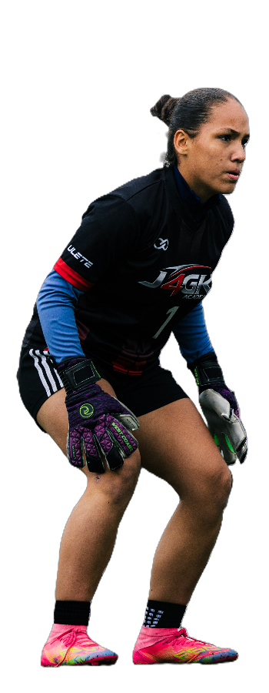
SECTION 4
TOPICS COVERED
COMMUNICATION
& MINDSET
VERBAL COMMANDS
"Keeper!" · "Away!" · "Leave it!" · "Wall!" · "Step!" · "Press!" · "Hold!"
COMMUNICATION PRINCIPLES
Early communication · Decisive call · Authoritative tone · Consistency
04
LEADERSHIP CONCEPTS
Command presence · Accountability · Trust-building · Culture setting
MENTAL PERFORMANCE
Composure · Visualization · Cue words · Process focus · Optimal arousal
Commands · Leadership · Mental
PRESSURE, ADVERSITY & IDENTITY
Mistake recovery · Resilience · Growth mindset · GK identity
Just4GK • Goalkeeper-Exclusive Training • www.just4gk.net • jerimy@just4gk.net

Slide 17
COMMUNICATION
VERBAL COMMANDS
21 calls · Every command a goalkeeper must know and use
"KEEPER!" | The keeper's call to claim a ball — must be loud, early, and decisive to communicate full ownership.
"AWAY!" | A command to defenders to clear the ball — used when the keeper cannot or should not come for it.
"LEAVE IT!" | Telling a teammate to let the ball run through to the keeper — requires trust and precise timing.
"MAN ON!" | Warning a teammate that an opponent is closing in from behind — gives them time to react.
"TURN!" | Telling a teammate they have space and time to turn with the ball — no pressure from behind them.
"TIME!" | Letting a teammate know they are not under immediate pressure — they can take a touch and settle.
"PRESS!" | Commanding defenders to close down the opponent on the ball — triggers the team's defensive press.
"HOLD!" | Instructing the defensive line to stay in place and not step forward — maintains shape and coverage.
"STEP!" | Directing the defense to push the line forward — often to play attackers offside on a through ball.
"DROP!" | Instructing the defensive line to retreat and hold a deeper, more protected position behind the ball.
"PUSH UP!" | Directing teammates to move higher up the field as a compact unit after winning possession.
"LINE!" | Reminding defenders to maintain their defensive shape and stay level with each other across the pitch.
"SET!" | Alerting teammates that a set piece is about to be taken — everyone must be organized and ready.
"NEAR POST!" | Directing a defender to cover the near post on a cross or set piece — closes the most dangerous angle.
"FAR POST!" | Directing a defender to cover the back post — prevents an unmarked run to the far side of the goal.
"WALL!" | Organizing defenders into a wall on a free kick — followed by number of players and position calls.
"SIX!" | Calling to organize defenders in the six-yard box on a corner or set piece delivery.
"OUT!" | Directing everyone to step forward as a unit after a clearance or claim — resets the defensive line.
"BOX!" | Calling for teammates to get into the penalty area — typically to receive a goal kick or short pass.
"YOURS!" | Telling a teammate that a ball is their responsibility — opposite of "Keeper!" — assigns ownership clearly.
"SHORT!" | Indicating to a teammate the keeper wants a short pass rather than a clearance — initiates possession play.
COMMUNICATION
COMMUNICATION PRINCIPLES
12 terms · Standards and principles behind effective keeper communication
EARLY COMMUNICATION | Calling before the play develops — giving defenders maximum time to respond and organize themselves.
LOUD AND CLEAR | The standard for all keeper commands — must cut through crowd noise, match intensity, and player movement.
DECISIVE CALL | A command with no hesitation or uncertainty — ambiguity in calls causes collisions, missed clearances, and goals.
REPEATED CALL | Saying a command more than once to ensure it's heard and understood under match conditions and crowd noise.
TWO-WAY COMMUNICATION | Both giving and receiving information — listening to teammates' calls is as important as making your own.
NON-VERBAL COMMUNICATION | Using hand signals, eye contact, and body language to communicate when verbal calls can't be heard.
PRE-MATCH COMMUNICATION | Establishing expectations, patterns, and cues with defenders before the game begins — sets the defensive standard.
CALM VOICE | Maintaining a composed, controlled tone during high-pressure moments — panic in the keeper's voice spreads to the team.
AUTHORITATIVE TONE | Speaking with confidence and conviction — the keeper's voice should signal control, not uncertainty or hesitation.
COMMUNICATION CONSISTENCY | Using the same calls in the same situations every time — predictability builds trust with defenders over time.
HALF-TIME COMMUNICATION | Addressing defensive shape, marking assignments, and set piece organization during the break with clarity.
IN-GAME ADJUSTMENTS | Updating teammates on tactical changes, threats, or positioning shifts as the game evolves throughout the match.

Slide 18
COMMUNICATION
LEADERSHIP CONCEPTS
13 terms · Leading from the goalkeeper position
COMMAND PRESENCE | The ability to project authority and confidence that organizes and reassures teammates — the keeper's most visible leadership quality.
DEFENSIVE LEADER | The keeper's role as the last line of defense and primary organizer of the entire backline — ownership, not just position.
FIELD GENERAL | A keeper who reads the game from behind and directs the entire team like a coach on the field — the complete leadership role.
OWNERSHIP MENTALITY | Taking full responsibility for the space, decisions, and culture in and around the penalty area — no excuses, no deflection.
ACCOUNTABILITY | Owning mistakes without deflecting — acknowledging the error and immediately refocusing on the next action.
SETTING THE STANDARD | Modeling the level of effort, communication, and professionalism expected of the entire team through your own actions.
POSITIVE REINFORCEMENT | Verbally affirming a teammate's good action — builds confidence in defenders and strengthens the defensive unit.
CONSTRUCTIVE FEEDBACK | Correcting a teammate's error in a clear, supportive way that improves performance without damaging their confidence.
TRUST-BUILDING | Earning the confidence of defenders through consistent, clear communication and reliable decision-making over time.
EMOTIONAL REGULATION | Managing personal emotions during the game to maintain a stable, trustworthy presence for the entire team.
BODY LANGUAGE LEADERSHIP | Using posture, eye contact, and energy to communicate confidence — teammates read and reflect the keeper's body at all times.
CULTURE SETTING | The keeper establishing the standards for effort, communication, and character within the team environment.
ORGANIZING ON SET PIECES | Taking charge of wall placement, marking assignments, and positioning before every dead ball — every single time.

Slide 19
MINDSET
MENTAL PERFORMANCE
20 terms · Core mental skills and psychological concepts for goalkeepers
MENTAL RESILIENCE | The ability to recover from mistakes, setbacks, and adversity without a lasting drop in performance or focus.
COMPOSURE | Remaining calm and focused under pressure — the most prized mental quality in any goalkeeper at any level.
CONFIDENCE | A keeper's belief in their own ability — built through preparation, repetition, and positive competitive experience.
SELF-EFFICACY | The specific belief that you can execute a skill or action successfully in a given moment under pressure.
FOCUS | Directing attention to the right cues at the right time — tuning out distractions and irrelevant information.
CONCENTRATION | Sustaining focus across an entire match — including long periods of inactivity followed by sudden explosive demands.
OPTIMAL AROUSAL | The ideal mental and physical activation level for a keeper to perform their best — not too relaxed, not too anxious.
AROUSAL CONTROL | Managing energy levels before and during a match — breathing, routine, and self-talk are the primary tools.
VISUALIZATION | Mentally rehearsing saves, distributions, and decisions before they happen — trains the brain like physical reps.
MENTAL REHEARSAL | Pre-performing scenarios in the mind — scripts the body for real execution when the moment arrives in a match.
PROCESS FOCUS | Concentrating on what you control — technique, effort, decision — rather than outcome (score, result, opponent).
PRESENT MOMENT FOCUS | Staying locked on the current moment — not replaying past mistakes or worrying about future scenarios.
NEXT-PLAY MENTALITY | The instant reset after a mistake — acknowledging it and immediately returning full attention to the game.
MINDFULNESS | Non-judgmental awareness of thoughts, sensations, and environment in the present moment — a trainable mental skill.
COGNITIVE REFRAMING | Changing the interpretation of a situation — turning "I made a mistake" into "I have information to improve."
POSITIVE SELF-TALK | Internal language that reinforces confidence and execution — replacing doubt with constructive, action-oriented cues.
CUE WORDS | Short, powerful words used to trigger focus, reset, or execute a skill — examples: "Set," "Track," "Reset," "Next."
PRE-PERFORMANCE ROUTINE | A consistent sequence of physical and mental actions before a match or training to reach optimal readiness.
BREATHING CONTROL | Using deliberate breathing patterns to manage arousal, calm the nervous system, and restore focus mid-game.
PERFORMANCE ANXIETY | Excessive nervousness that impairs decision-making and movement — recognized and managed, not suppressed.

Slide 20
MINDSET
PRESSURE, ADVERSITY & IDENTITY
20 terms · Resilience, confidence, and goalkeeper identity
MISTAKE RECOVERY | Acknowledging an error and returning to full performance engagement immediately — the defining resilience skill.
BOUNCE-BACK ABILITY | How quickly and completely a keeper recovers confidence and performance level after conceding a goal.
ERROR COMPARTMENTALIZATION | Setting a mistake aside mentally to prevent it from affecting the very next action in the game.
PRESSURE INOCULATION | Training under simulated pressure so real match pressure feels familiar, manageable, and not overwhelming.
ADVERSITY TOLERANCE | Maintaining effort and focus when conditions are difficult — bad weather, losing scores, hostile environments.
RESILIENCE CYCLE | The repeatable pattern: experience adversity → acknowledge → reset → re-engage — each loop is trainable.
EMOTIONAL RECOVERY | Returning to a neutral emotional state after a frustrating event — prevents compounding errors in the same game.
HIGH-STAKES MOMENTS | Penalties, 1v1s, final minutes — moments where mental readiness determines outcomes as much as technique does.
GRIT | Passion and sustained perseverance through difficulty — a long-term mental quality developed over seasons, not sessions.
ACCOUNTABILITY W/O SHAME | Taking responsibility for mistakes without internalizing them as a reflection of personal identity or worth.
GOALKEEPER IDENTITY | A keeper's sense of self and belonging in the position — "I am a goalkeeper" as a core and valued identity statement.
ROLE CLARITY | A clear understanding of responsibilities, expectations, and strengths within the team and the position itself.
PREPARED CONFIDENCE | Confidence built through deliberate preparation — not arrogance, but the earned belief that comes from hard work.
BRAVERY | The willingness to take risks, make decisions, and act under uncertainty — a trainable mental quality, not just a trait.
COURAGE UNDER FIRE | Making the right decision (coming for a cross, diving at feet) even when the physical or emotional risk is very real.
GROWTH MINDSET | The belief that ability develops through effort and learning — essential for long-term goalkeeper development at any level.
FIXED MINDSET | The belief that ability is static — limits a keeper's willingness to try, fail, and ultimately grow from experience.
IDENTITY SEPARATION | Keeping performance outcomes separate from personal worth — a bad game does not make you a bad goalkeeper.
COACHABILITY | The openness to receive feedback, adjust, and grow — a defining mental quality of every successful goalkeeper.
CHAMPION MENTALITY | A commitment to excellence in preparation, effort, and standard — regardless of opponent, score, or circumstance.

