Slide 1

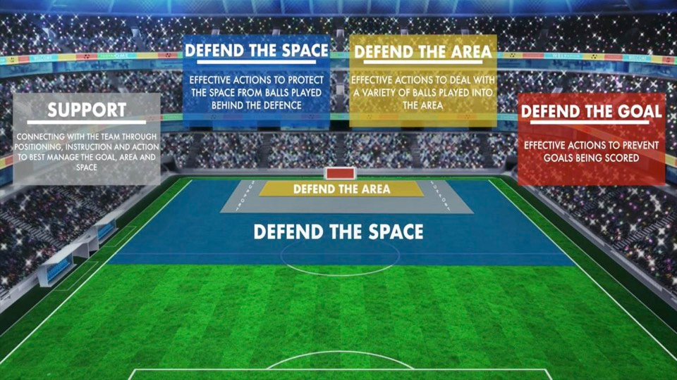
JUST4GK · GOALKEEPER DEVELOPMENT
CURRICULUM MODULE · DEFENSIVE CONCEPTS
JUST4GK
Defending the Goal,
the Area & the Space
COMPREHENSIVE
GOALKEEPER CURRICULUM
A framework for understanding a goalkeeper's three defensive zones — and knowing when to operate in each one.
Zone 1 · Goal
Zone 2 · Area
Zone 3 · Space
Just4GK • Goalkeeper-Exclusive Training • www.just4gk.net • jerimy@just4gk.net

Slide 2
JUST4GK · MODULE OVERVIEW
THE THREE
DEFENSIVE
ZONES
On / Inside the Goal Line
1
DEFENDING THE GOAL
Shot-stopping, one-on-ones, penalties, reaction saves — the last line of defense.
2
DEFENDING THE AREA
Inside the 18-Yard Box
Claiming crosses, commanding set pieces, organizing defenders, owning the 18-yard box.
3
DEFENDING THE SPACE
Beyond the Penalty Area
Sweeper-keeper role — intercepting through balls, high line support, proactive positioning.
Every goalkeeper must operate across three distinct zones. Understanding when to shift between them separates a good keeper from a complete one.
Just4GK • Goalkeeper-Exclusive Training • www.just4gk.net • jerimy@just4gk.net

Slide 3

Key Responsibilities & Examples
ZONE 01 OF 03
What Does Zone 1 Look Like?
01
EXAMPLE 01
EXAMPLE 02
Shot-Stopping
One-on-One Situations
DEFENDING
THE GOAL
Set stance, read the shooter's body shape. Position hands correctly for low drives, mid-height efforts, and top-corner attempts.
Close down a striker who's broken through — force wide, reduce angle, and smother before they can place a shot.
The most traditional GK responsibility — stopping shots directed at the goal frame. This is the last line of defense. Everything else builds from here.
WHEN IS THIS ZONE ACTIVE?
A shot is directed at goal
EXAMPLE 03
EXAMPLE 04
Penalty Kicks
Reaction Saves
Read the shooter, hold position as long as possible, commit to a corner. Mental composure matters as much as athleticism.
Deflections off defenders, rebounds from posts, shots through a crowd — continuous readiness for second-chance balls.

Slide 4
Key Responsibilities & Examples
ZONE 02 OF 03
What Does Zone 2 Look Like?
02
EXAMPLE 01
EXAMPLE 02
Claiming Crosses
Set Piece Organization
DEFENDING
THE AREA
Step forward aggressively to catch or punch in-swinging and out-swinging balls. Call "KEEPER!" clearly and commit — no hesitation.
Direct defenders to mark runners, decide on zonal or man coverage, communicate clearly before the ball is delivered.
Extends the GK's responsibility into the penalty box — organizing, claiming, and controlling space in front of goal. The keeper should own every ball that enters the 18.
WHEN IS THIS ZONE ACTIVE?
Ball has entered the penalty box
EXAMPLE 03
EXAMPLE 04
Commanding Corners
Sweeping Second Balls
Decide early — come or stay — and commit loudly. No ball should drop unchallenged without a clear call.
Collecting loose balls inside the 18 after clearances — including dangerous cut-backs and balls across the six-yard box.
Just4GK • Goalkeeper-Exclusive Training • www.just4gk.net • jerimy@just4gk.net

Slide 5
Key Responsibilities & Examples
ZONE 03 OF 03
What Does Zone 3 Look Like?
03
EXAMPLE 01
EXAMPLE 02
Intercepting Through Balls
High Defensive Line Support
DEFENDING
THE SPACE
Read the ball played in behind the line — rush off the line to collect before the striker reaches it. Timing is everything.
Position near the top of the box so the team can press higher — act as an extra defender covering space in behind.
The sweeper-keeper role — playing proactively beyond the penalty area to kill threats before they develop. Requires advanced positioning and reading the game early.
WHEN IS THIS ZONE ACTIVE?
Ball played in behind the defense
EXAMPLE 03
EXAMPLE 04
Aerial Duels Outside the Box
Reading the Game Early
Come to meet long balls dropping behind the defensive line — requires communication and full commitment.
Anticipate a switch of play or second ball and adjust position before danger arrives — decision-making before the moment.
Just4GK • Goalkeeper-Exclusive Training • www.just4gk.net • jerimy@just4gk.net

Slide 6
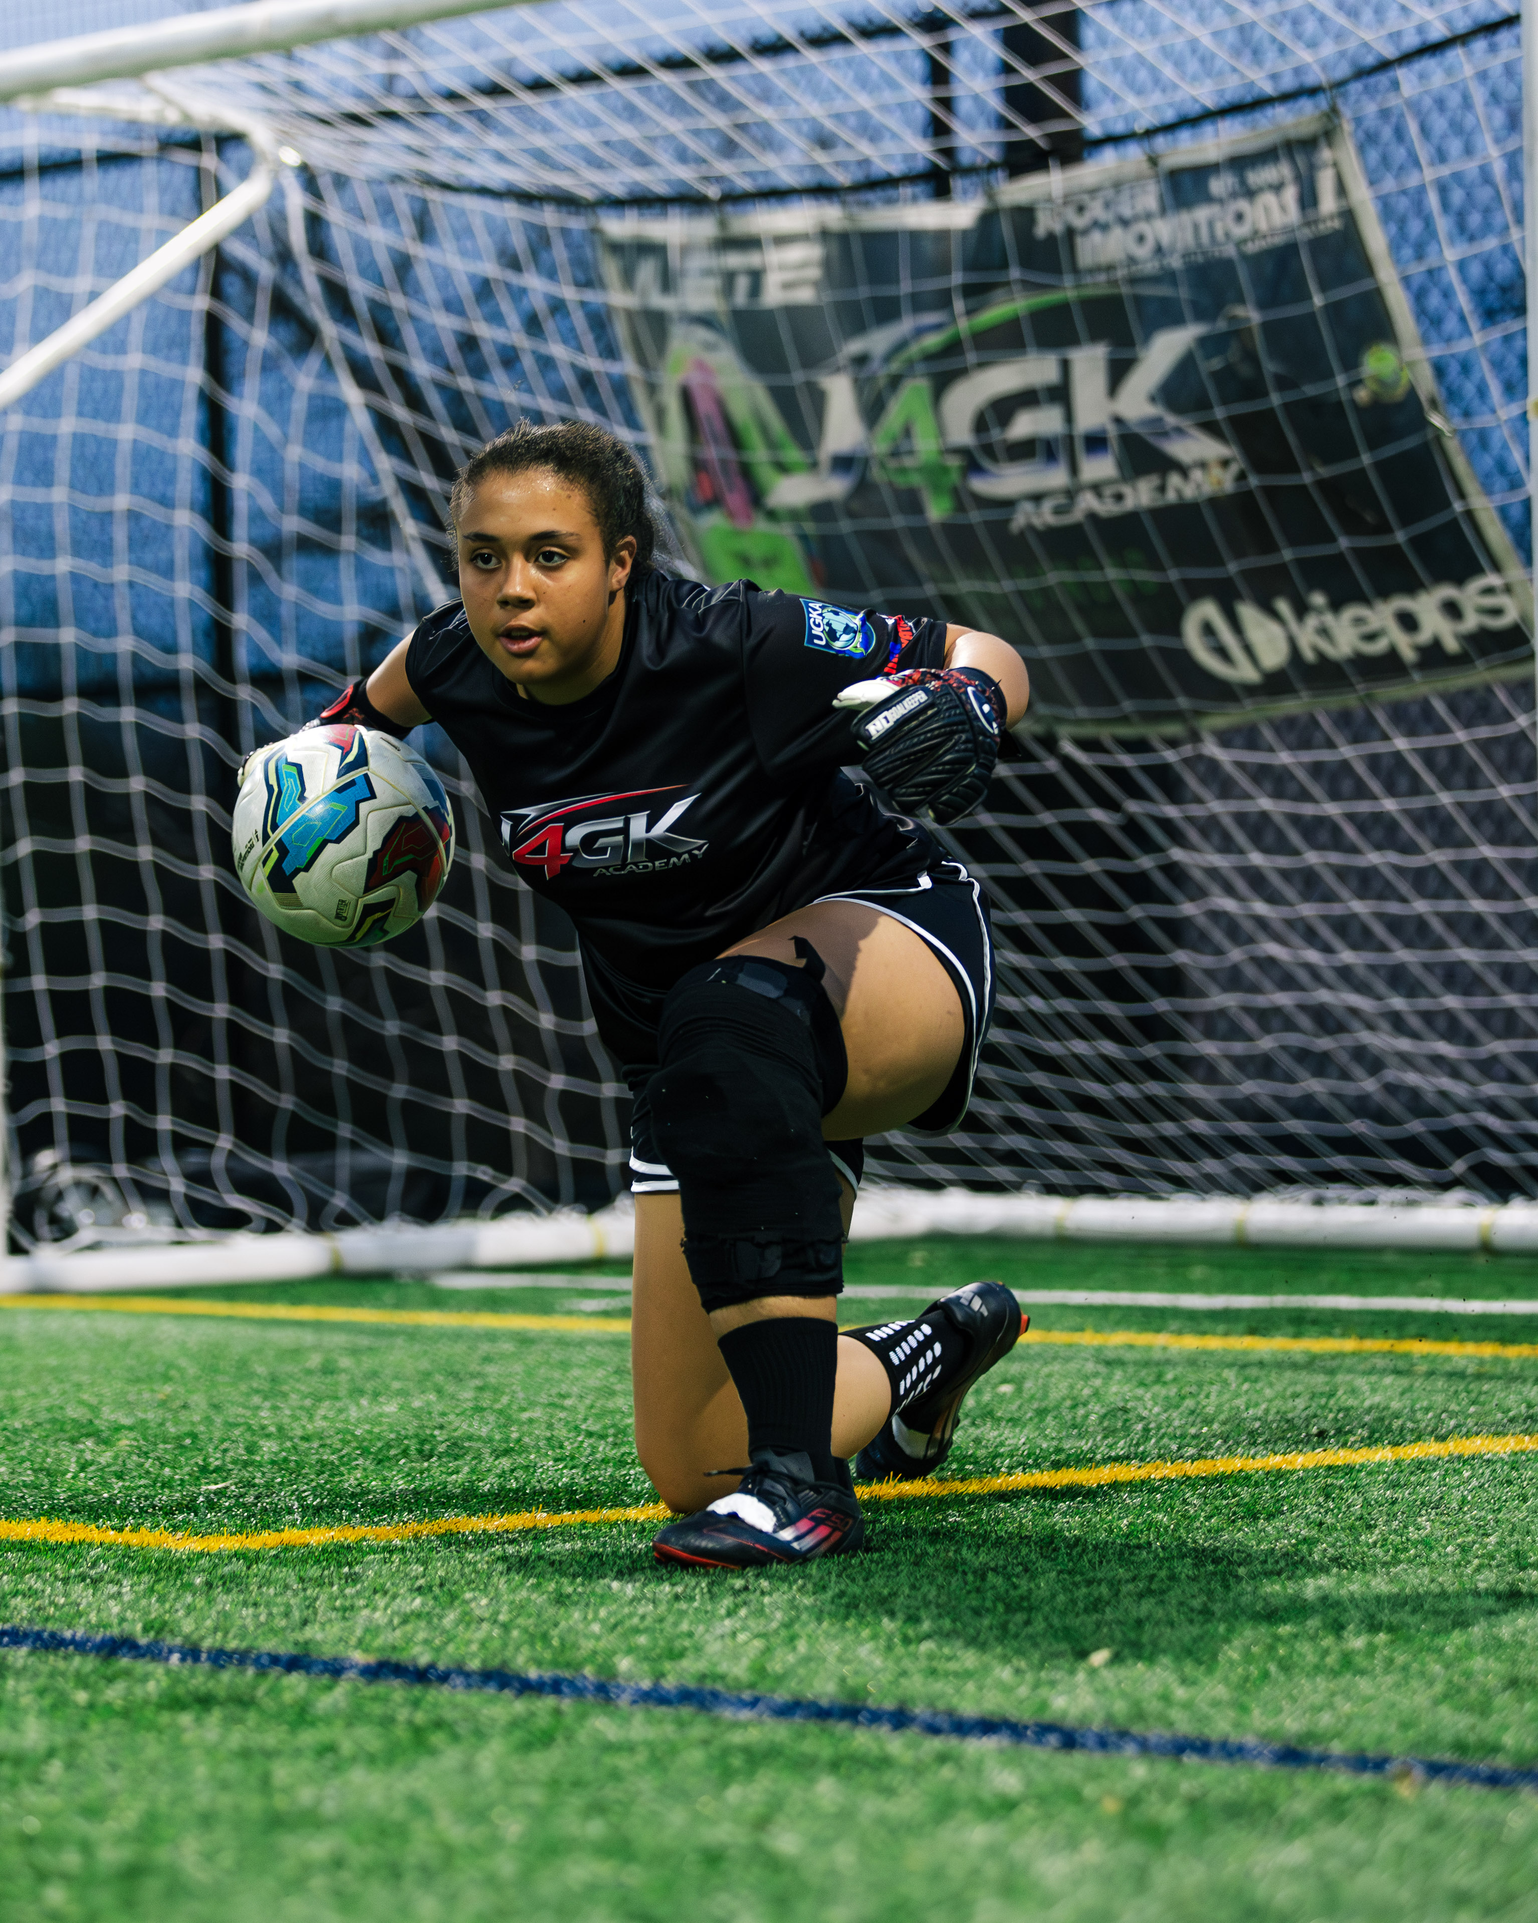

ZONE COMPARISON
ZONE
LOCATION
TRIGGER
KEEPER'S PRIMARY ACTION
HOW
THEY
CONNECT
1
Defending
the Goal
On / inside goal line
A shot is coming at goal
Stop the ball — shot-stopping, 1v1, penalty, reaction
2
Defending
the Area
Inside the 18-yard box
Ball entered penalty area
Claim, command, organize — crosses, set pieces, second balls
A complete keeper doesn't choose one zone — they move fluidly between all three based on where the threat is developing.
3
Defending
the Space
Beyond penalty area
Ball played in behind defense
Intercept proactively — rush out, read game, be first
Just4GK • Goalkeeper-Exclusive Training • www.just4gk.net • jerimy@just4gk.net

Slide 7
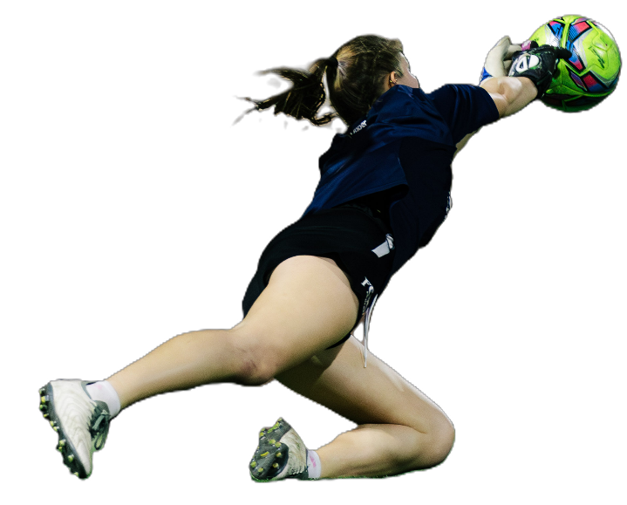
DECISION-MAKING
MENTAL FRAMEWORK
KNOWING
WHICH
MODE
YOU'RE IN
Three Principles for Zone Awareness
1
Read the Ball, Not Just the Player
Track the ball's trajectory — it tells you which zone is about to become active. Through ball = Zone 3. Cross into box = Zone 2. Shot on frame = Zone 1.
2
Adjust Position Before the Moment
Elite keepers are already moving into the right position while the ball is still in transition. Never wait for the zone to come to you.
3
Communicate Your Zone to the Defense
Your teammates need to know which zone you're covering. Constant verbal communication keeps the back line organized and confident.
The best goalkeepers don't react to zones — they anticipate them. That decision-making happens before the moment arrives.
"A complete keeper doesn't choose one zone — they move between all three, before the threat fully arrives."
Just4GK • Goalkeeper-Exclusive Training • www.just4gk.net • jerimy@just4gk.net

